Slide 1
Future Tactical Management System
Week 11 - Client Meeting 5

Slide 2
What we have done since last sprint
Ingenuity poster
Saving default settings
FlightFeed tool
Replay track module
Refactored code

Slide 3
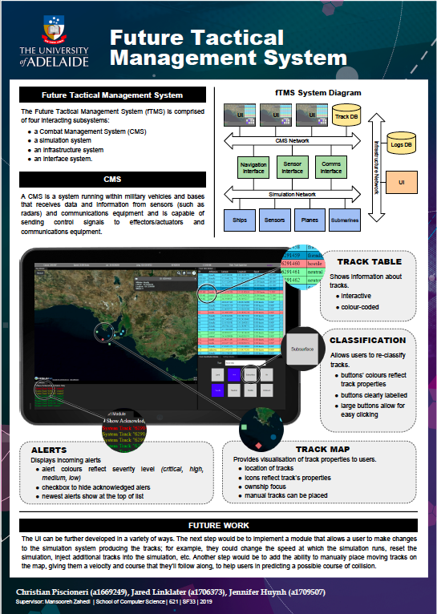

Slide 4
User Stories - Jared
As a user of the system, I want to see live flight data appear as tracks on the system, so that I can practice using the system’s features with a realistic data source. (Complete) (3)
As a user of the system, I want flight updates to occur at most every 10 seconds, so that tracks are moving at a reasonable rate. (Complete) (2)
As an administrator of the system, I want to be able to adjust the area that flight data is reported from so that I can test how the system performs with different levels of traffic. (Complete) (2)
As a user of the system, I want to be able to adjust which ID represents ownship so that, if needed, I can change the ownship to a more active track for demonstration purposes. (Complete) (2)
As a user of the system, I want to be able to click a button that scrolls the track table to the selected track, so that I do not have to scroll through the table and find the track manually. (Complete) (2)

Slide 5
User Stories - Jennifer
As a user of the system, I want changes I make to my settings to be saved to my account, so that I do not have to reconfigure my settings each time I log in. (Complete)(2)
As a user of the system, I want my saved settings to be automatically loaded the next time I log in, so that I am able to work with my preferred settings. (Complete)(3)
As a user of the system, I want to have the option to save a default layout to my account, so that my preferred layout is set up each time I log in. (Complete)(4)
As a user of the system, I want to have a recommended layout available to load, so that I will always be able to work with an efficient interface layout. (Complete)(1)
As a user of the system, I want to be able to focus the map on ownship so that I can keep track of my surroundings as it moves. (Complete)(2)
As a user of the system, I want to have a button to toggle in and out of the map’s ownship focus, so that I can look around the map freely when I need to. (Complete)(1)

Slide 6
User Stories - Christian
As a user of the system, I want to be able to playback previously-shown tracks so that I may review past events. (Complete)(5)
As a user of the system, I want to control track replay from a track replay module, so that it does not interfere with other parts of the system. (Complete)(1)
As a user of the system, I want to be able to specify a start and end time for the track replay mode. (Complete)(2)
As a user of the system, I want to be able to switch between live tracks and track replay through the use of a slider. (Complete)(3)
As a user of the system, I want to be able to play, pause and rewind the replay of the tracks. (Complete)(3)
As a user of the system, I want to be able to use a scrub bar (scrubber/seek bar) to change the point in time I am viewing in the track replay, so that I have a familiar interface I can use. (Complete)(1)

